Slide 1

Divorce Prediction
Application of Exploratory Data Analysis and Machine Learning

Slide 2
Agenda
Why I chose Divorce Prediction
Problem Statement
About the data
Exploratory Data Analysis
Correlation Heat Map
Kmeans Clustering
Neural Network Model for Predicting Divorce
Random Forest Classification for Feature Importance
Conclusion

Slide 3
Why I chose Divorce Prediction
I wanted to look into what factors drive divorce
I wanted to create a model which can help professionals assess the participants in couples therapy.
This can lead to early intervention and possibly save the relationship

Slide 4
Problem Statement
Which questions/factors are most significant when predicting divorce?
What are the key indicators for divorce?

Slide 5
About the data
Data was gathered by having participants answer the Divorce Predictors Scale.
The questionnaire contains questions ranging from how couples interact with each other during their arguments up to whether they share the same goals or not.
The data excludes other factors such as social standing of the partner, whether they have children or not, and length of relationship.
Data is obtained from a published research in the development of a predictive model for divorce using Artificial Neural Network and Correlation Based feature selection
170 initial sample - 20 duplicates = 150 usable samples
150X55 dataframe size

Slide 6
About the data
If one of us apologizes when our discussion deteriorates, the discussion ends.
I know we can ignore our differences, even if things get hard sometimes.
When we need it, we can take our discussions with my spouse from the beginning and correct it.
When I discuss with my spouse, to contact him will eventually work.
The time I spent with my wife is special for us.
We don't have time at home as partners.
We are like two strangers who share the same environment at home rather than family.
I enjoy our holidays with my wife.
I enjoy traveling with my wife.
Most of our goals are common to my spouse.
I think that one day in the future, when I look back, I see that my spouse and I have been in harmony with each other.
My spouse and I have similar values in terms of personal freedom.
My spouse and I have similar sense of entertainment.
Most of our goals for people (children, friends, etc.) are the same.
Our dreams with my spouse are similar and harmonious.
We're compatible with my spouse about what love should be.
We share the same views about being happy in our life with my spouse
My spouse and I have similar ideas about how marriage should be
My spouse and I have similar ideas about how roles should be in marriage
My spouse and I have similar values in trust.
I know exactly what my wife likes.
I know how my spouse wants to be taken care of when she/he sick.
I know my spouse's favorite food.
I can tell you what kind of stress my spouse is facing in her/his life.
I have knowledge of my spouse's inner world.
I know my spouse's basic anxieties.
I know what my spouse's current sources of stress are.
I know my spouse's hopes and wishes.
I know my spouse very well.
I know my spouse's friends and their social relationships.
I feel aggressive when I argue with my spouse.
When discussing with my spouse, I usually use expressions such as ‘you always’ or ‘you never’ .
I can use negative statements about my spouse's personality during our discussions.
I can use offensive expressions during our discussions.
I can insult my spouse during our discussions.
I can be humiliating when we discussions.
My discussion with my spouse is not calm.
I hate my spouse's way of open a subject.
Our discussions often occur suddenly.
We're just starting a discussion before I know what's going on.
When I talk to my spouse about something, my calm suddenly breaks.
When I argue with my spouse, ı only go out and I don't say a word.
I mostly stay silent to calm the environment a little bit.
Sometimes I think it's good for me to leave home for a while.
I'd rather stay silent than discuss with my spouse.
Even if I'm right in the discussion, I stay silent to hurt my spouse.
When I discuss with my spouse, I stay silent because I am afraid of not being able to control my anger.
I feel right in our discussions.
I have nothing to do with what I've been accused of.
I'm not actually the one who's guilty about what I'm accused of.
I'm not the one who's wrong about problems at home.
I wouldn't hesitate to tell my spouse about her/his inadequacy.
When I discuss, I remind my spouse of her/his inadequacy.
I'm not afraid to tell my spouse about her/his incompetence.

Slide 7
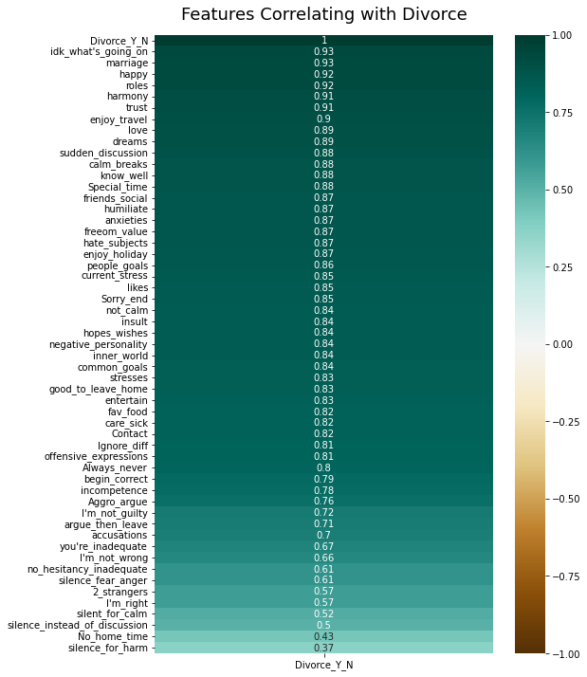
Exploratory Data Analysis: Heat Map

Slide 8
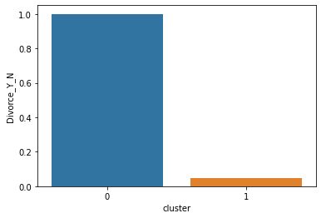
Kmeans Clustering

Slide 9
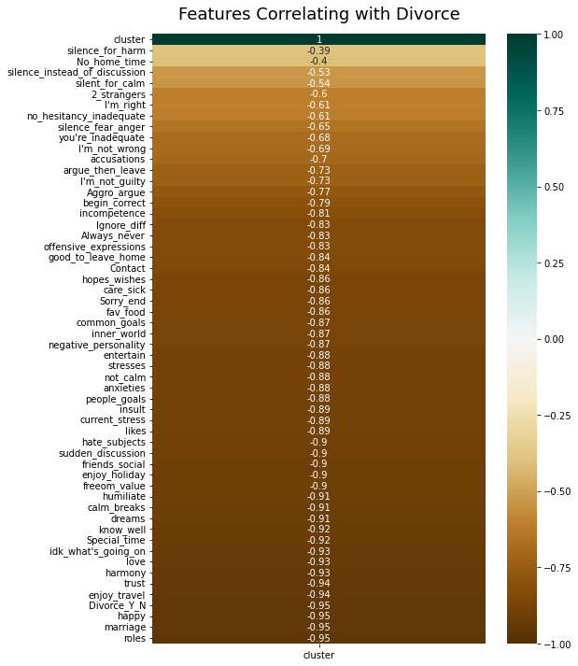
Kmeans Clustering: Heat Map

Slide 10
Heat Map Comparison

Slide 11
Implementation of Neural Network Model
Used PCA to reduce the features to be used from 54 to 4 retaining 82% variance
Tested 3 variations before settling on a final model
Final model is able to achieve 97 % accuracy in prediction

Slide 12
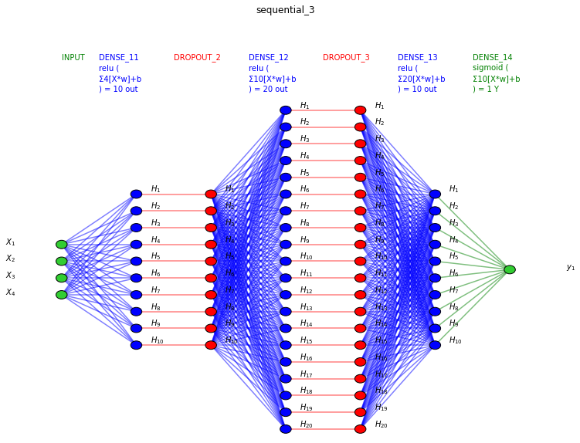
Neural Network Model

Slide 13
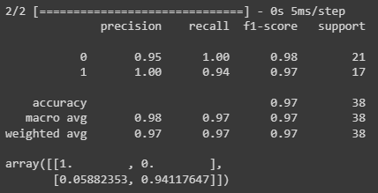
Neural Network Model Metrics

Slide 14
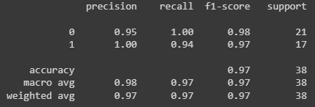
Random Forest Classifier Model Metrics

Slide 15
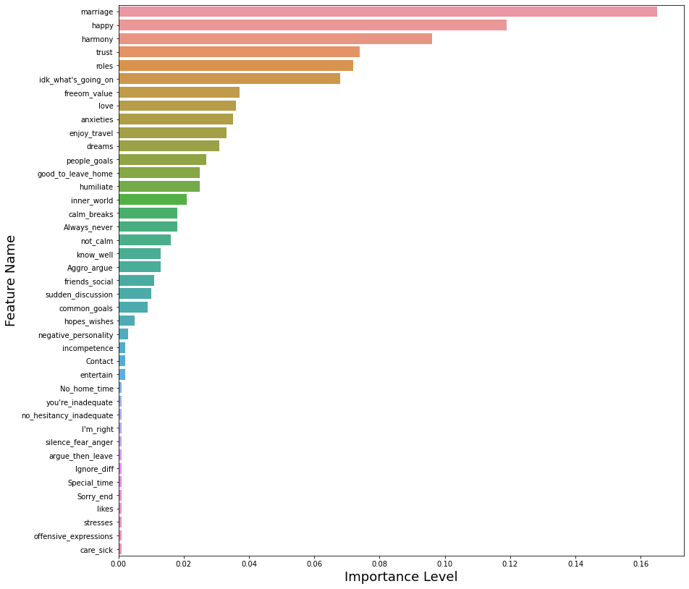
Feature Importance

Slide 16
Conclusion
Out of 54 questions, only 41 carry weight in predicting divorce based on feature importance
There are 6 significant questions that carries the most weight:
similar ideas about how marriage should be
share the same views about being happy in their life
foresee a future where they think they had a harmonious relationship
similar values in trust
similar ideas about how roles should be in marriage
starting a discussion before knowing what's going on.

Slide 17
References
How to Create a Seaborn Correlation Heatmap in Python? | by Bibor Szabo | Medium
(PDF) DIVORCE PREDICTION USING CORRELATION BASED FEATURE SELECTION AND ARTIFICIAL NEURAL NETWORKS  (researchgate.net)
Correlation-based Feature Selection in Python from Scratch – Johannes S. Fischer (johfischer.com)
Project2.ipynb - Colaboratory (google.com)
Ecommerce Customer Retention Analysis and Prediction.ipynb - Colaboratory (google.com)
Etherum Fraud Detection.ipynb - Colaboratory (google.com)

